Slide 1
Local Tobacco Control Profiles https://fingertips.phe.org.uk/profile/tobacco-control
Responsible statistician/product lead: Mark Cook
For queries relating to this document, please contact: tobacco.profiles@phe.gov.uk.
First published: March 2021
© Crown copyright 2020
Re-use of Crown copyright material (excluding logos) is allowed under the terms of the Open Government Licence, visit www.nationalarchives.gov.uk/doc/open-government-licence/version/2/ for terms and conditions

Slide 2
Key facts for England
Smoking prevalence in adults
smoking prevalence in adults was 12.1% in 2020
the odds of smoking for routine and manual workers was 2.1 times that of other occupations
the prevalence of women smoking at time of delivery in 2020/21 was 9.6% in England.
smoking prevalence was 40.5% for people with serious mental health illness in 2014/15
25.8% of adults with a long-term mental health condition were current smokers in 2019/20
smoking prevalence in people admitted to treatment for substance misuse ranged from 43.9% for alcohol to 70.2% for all opiates
Smoking related mortality
smoking attributable mortality was 202 per 100,000 (age 35+) in England for 2017-19
there were an estimated 1,313 years of life lost per 100,000 due to smoking attributable illnesses, including various cancers, heart disease, stroke and chronic obstructive pulmonary disease.
Smoking prevalence in young people
it is estimated that 5.3% of 15 year olds were regular smokers in 2018 and 6.1% occasional smokers
25% of 15 year olds had tried an e-cigarette in 2018 and 2% were regular users.
Impact of Smoking
for 2019/20 the estimated tax gap from illicit tobacco was £2.3 Billion, which represents 9% of cigarette sales
Smoking related ill health
in 2019/20 there were 1,398 smoking attributable hospital admissions per 100,000 population (age 35+)
other smoking related health conditions include lung and oral cancers, premature births, low birth weight babies and asthma
Smoking quitters
In 2019/20 221,678 people set a quit date
There were 1,808 successful quitters per 100,000 smokers, 62% of which were CO validated.

Slide 3
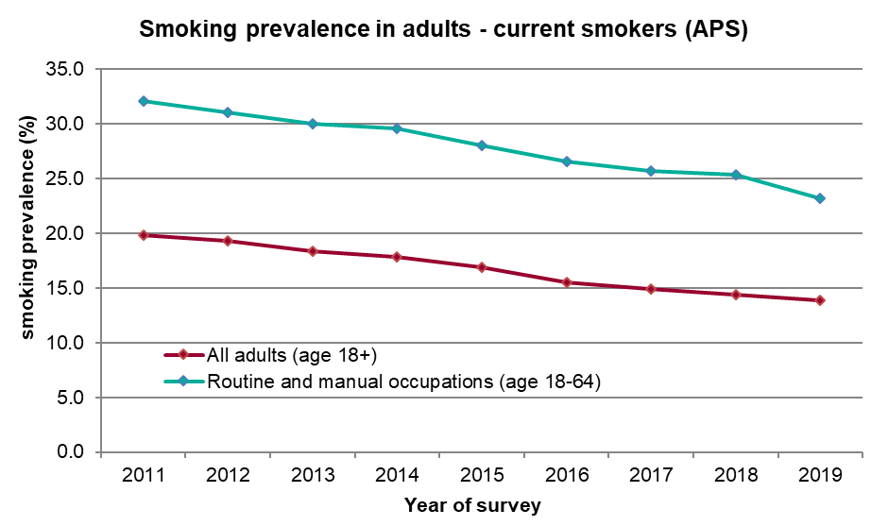
Smoking prevalence in adults
Various data sources can be used to estimate smoking prevalence in adults, which produce differing results due to the survey method¹.
The most widely used survey for estimating
smoking prevalence is the Annual Population
Survey due to its large sample size and
frequency (around 175,000 people in
England per year).
Smoking prevalence (APS) in Upper Tier Local Authorities ranged from 5.5% in Wokingham to 20.8% in Manchester in 2020.
As the data in 2020 cannot be compared to previous years, only trends up to 2019 can be shown. There has been a decline in smoking prevalence in recent years (from 19.8% in 2011 to 13.9% in 2019), however, as highlighted in the 2017 Tobacco Control Plan², there remains a higher prevalence of smoking in routine and manual occupations compared with England as a whole (32.1% in 2011 to 23.2% in 2019). The gap between smoking prevalence in routine & manual and other occupations has widened between 2012 (odds ratio 2.27) and 2019 (odds ratio 2.46).
1 https://fingertips.phe.org.uk/profile/tobacco-control/supporting-information/further-info for more details
2 https://www.gov.uk/government/publications/towards-a-smoke-free-generation-tobacco-control-plan-for-england

Slide 4
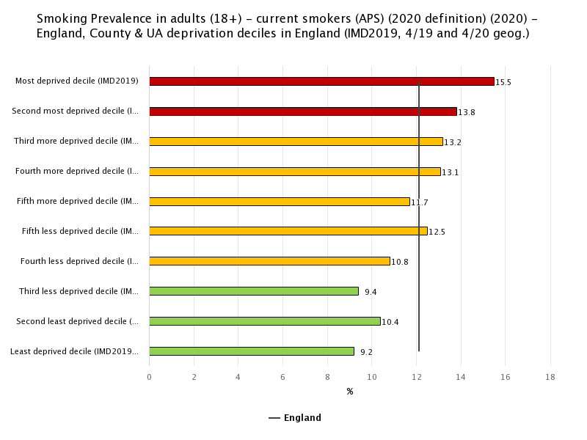
Smoking prevalence in adults Inequalities in smoking prevalence: APS 2020

Slide 5
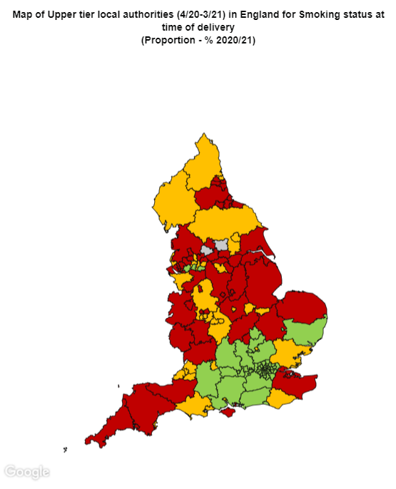
Smoking prevalence in adults Pregnancy and mental health
9.6% of women were recorded as smokers at time of delivery in 2020/21. There continues to be variation between CCG’s, with values ranging from 1.9% in NHS West London to 21.4% in NHS Blackpool. The proportion of unknowns in the recording of smoking status remains a concern (1.3% of maternities in 2020/21).
40.5% of adults with serious mental illness were recorded as current smokers in 2014/15, with all local authorities recording proportions significantly higher than the smoking prevalence in England (16.9% in 2015). Values ranged from 52.3% in Kingston upon Hull to 27.2% in Harrow.
Further indicators calculated from the GP Patient Survey show that 25.8% of adults with a long term mental health condition were smokers in 2019/20 compared with 14.3% of all respondents in the same survey in this period. Rates range from 42.7% in Tower Hamlets to 11.8% in Herefordshire. The gap in smoking prevalence by mental health status has narrowed between 2013/14 (odds ratio 2.79) and 2019/20 (odds ratio 2.36).

Slide 6
Smoking prevalence in young people
There are two surveys used to estimate smoking prevalence in young people at age 15.
The Smoking, Drinking and Drug Use in Young People is a biennial (previously annual) survey, providing national estimates for regular smokers and occasional smokers:
latest figures for 2018 showed 5.3% of 15 year olds smoked regularly and a further 6.1% smoked occasionally
25% of 15 year olds had tried an e-cigarette in 2018 and 2% were regular users
The What about YOUth? survey was carried out in 2014/15* and provides local authority estimates, although there are currently no plans for this to be repeated. Some key findings from the survey were:
regular smoking prevalence was 5.5%
occasional smoking prevalence was 2.7%
the highest prevalence of regular smoking was 11.1% in Blackpool and the lowest was 1.3% in Waltham Forest
occasional smoking ranged from 7.6% in Richmond upon Thames to 0.6% in Sandwell.
there appears to be no relationship between smoking at age 15 and deprivation levels in the local authority
18.4% of 15 year olds have ever tried an e-cigarette, and 15.2% have ever used other tobacco products
* The smoking prevalence estimates from the What About YOUth? (WAY) survey are lower than those seen in the SDD survey. This is likely to be mainly due to the differences in survey method used. The WAY survey was answered at home whereas the SDD survey was answered at school under exam conditions. It appears that 15 year olds feel more able to honestly answer questions on smoking when asked away from the home setting.

Slide 7
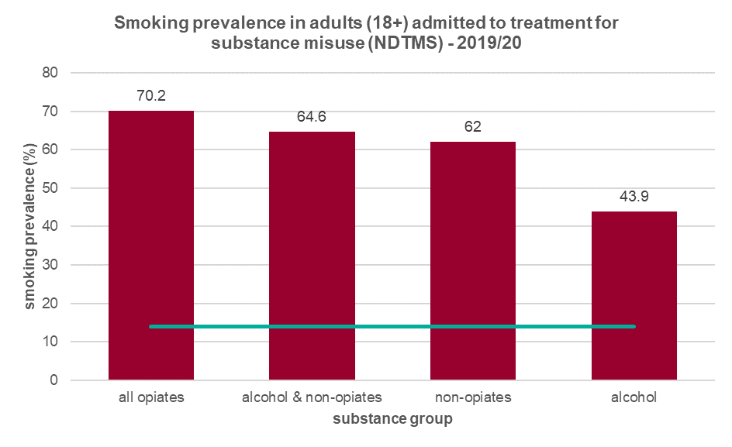
Smoking prevalence in adults admitted to treatment for substance misuse (NDTMS)
The latest PHE publication on the National Drug Treatment Monitoring System (NDTMS) reported that nearly 49,000 people said they had smoked tobacco in the 28 days before starting treatment yet only around 3% were recorded as having been offered referrals for smoking cessation interventions³.
Smoking prevalence varied depending on the substances that individuals were receiving treatment for, however all groups had significantly higher smoking prevalence than the general population (13.9% in 2019, estimated from the Annual Population Survey (APS) – the teal line on the chart) and other high risk groups such as routine and manual workers (23.2% in 2019, APS) and those with a long-term mental health condition (25.8% in 2019/20, GP Patient Survey).
Variation was also seen between Local Authorities, with the highest prevalence reported in Luton and in Norfolk where 90.9% of people being treated for opiate misuse were smokers compared with 41.4% in Sutton. For those in treatment for alcohol misuse, smoking prevalence ranged from 17.6% in York to 63.6% in Southend-on-Sea.
3 https://www.gov.uk/government/statistics/substance-misuse-treatment-for-adults-statistics-2019-to-2020/adult-substance-misuse-treatment-statistics-2019-to-2020-report#smoking
Also see https://www.gov.uk/government/statistics/substance-misuse-treatment-in-secure-settings-2019-to-2020 for further details

Slide 8
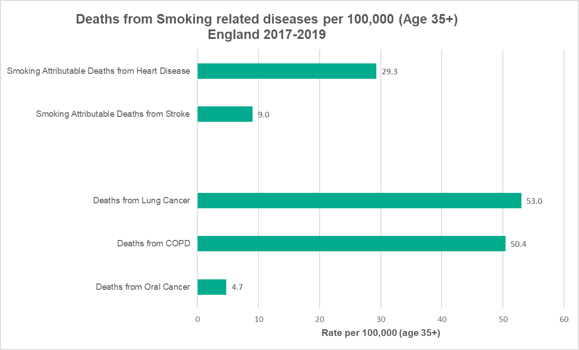
Smoking related mortality
Smoking attributable mortality was 202.2 per 100,000 population (age 35+) in England for 2017-19. Of this, 29.3 per 100,000 deaths were related to heart disease and 9 per 100,000 to stroke.
There is clear variation between local authorities, with smoking attributable mortality ranging from 419.7 per 100,000 in Kingston upon Hull to 103.4 per 100,000 in Harrow.
A high proportion of deaths related to chronic obstructive pulmonary disease (COPD), lung cancer and oral cancer are also caused by smoking.
There were 1,313 years of life lost per 100,000 due to smoking related illness in the period 2016-18 (age 35-74 years). There was a clear deprivation gradient, with 2,018 per 100,000 years of life lost in the most deprived compared with 899 per 100,000 in the least deprived.
Smoking is a risk factor for stillbirth and neonatal mortality, which in England in 2017-19 had rates of 4.0 per 1,000 live and stillbirths and 2.8 per 1,000 live births respectively.

Slide 9
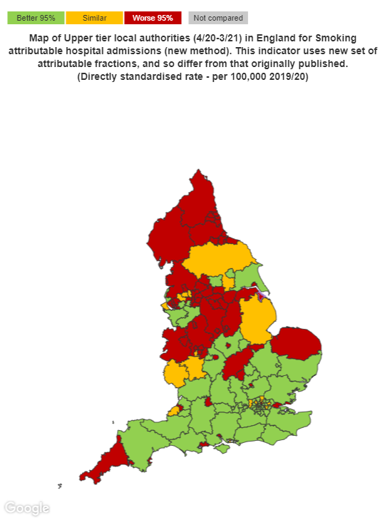
Smoking related illness
There were 1,398 smoking attributable hospital admissions per 100,000 population (age 35+) in 2019/20 in England. In upper tier local authorities rates varied from 516 per 100,000 in Wokingham to 3,071 per 100,000 in Blackpool.
The England rate of emergency admissions for COPD was 415 per 100,000, and for asthma in young people (under 19 years) was 161 per 100,000. Both indicators show that figures for males are significantly higher than females (422 compared to 413 per 100,000 for COPD and 183 compared to 137 per 100,000 for asthma).
Various cancers are highly associated with smoking and registration rates for 2016-18 in England there were 77.9 per 100,000 for lung cancer, 15.0 per 100,000 for oral cancer and 15.4 per 100,000 for oesophageal cancer.
Smoking in pregnancy can affect newborn babies. In England there were 81.2 premature births per 1,000 live births in 2016-18, and 2.9% of babies born in 2018 at term (37+weeks gestation) were low birth weight (under 2500g).

Slide 10
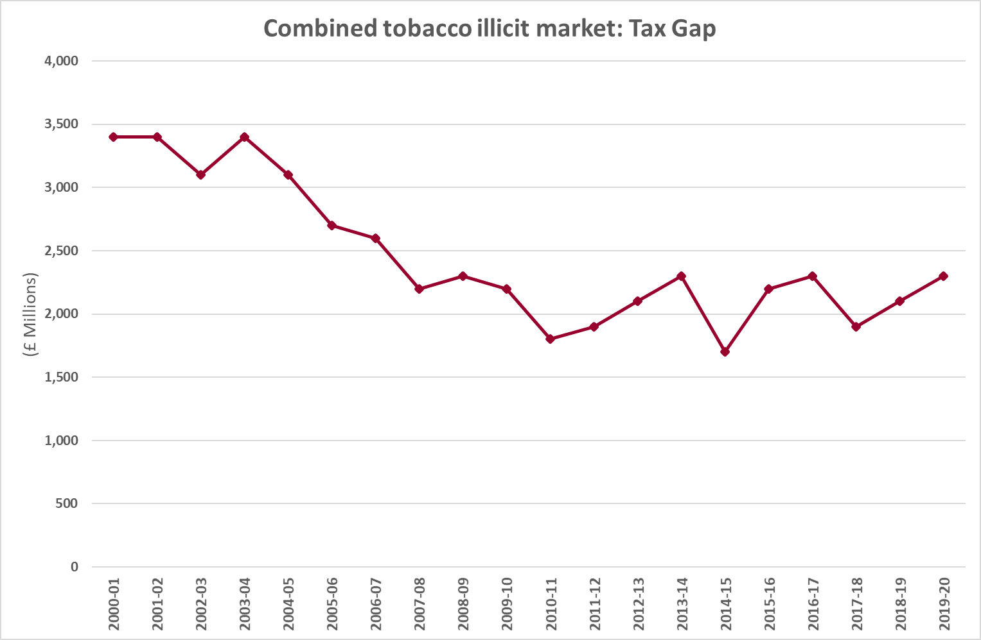
Impact of smoking
There was an estimated tax gap of £2.3 billion due to the combined illicit markets in tobacco in 2019/20 which is consistent with the previous year. An estimated 9% of cigarette sales were attributed to illicit
tobacco.
Of all the accidental fires in England in 2018/19, 7.8% were ignited by smoking related materials. And of all the fatalities from accidental fires, 26.95% were from fires caused by smoking related materials.
The What About YOUth? Survey asked 15 year olds about their perception of the harm of smoking and on average 91% of respondents recognised that smoking can cause harm to non-smokers, which demonstrates that young people in general understand the effects of second-hand smoke.

Slide 11
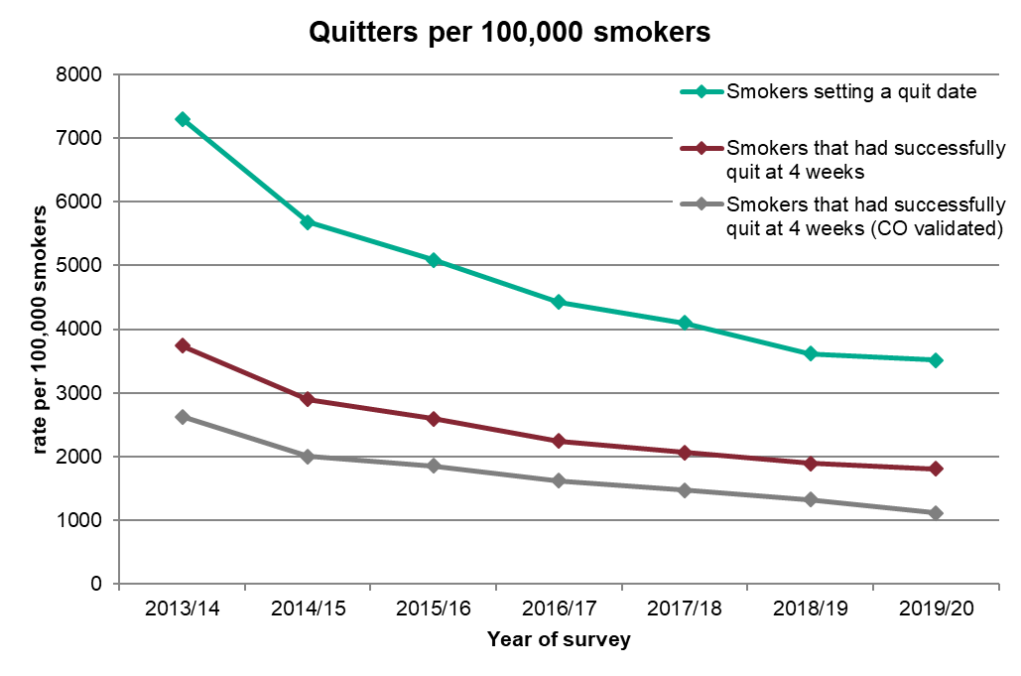
Smoking quitters
In England in 2019/20, 3,512 per 100,000 smokers set a quit date, which continues the decreasing trend seen in recent years. This perhaps explains why the number of successful quitters also continues to decline, with 1,808 successful quitters at 4 weeks per 100,000 smokers in 2019/20, 62% of whom were CO validated (1,113 per 100,000 smokers).
On average in 2019/20, the cost per quitter in England was £484. Between regions, costs ranged from £383 per quitter in the West Midlands to £710 in the North East.
The completeness of recording of social class by stop smoking services remains a concern, as it is essential that they monitor how their service is being used by the higher risk group in routine and manual occupations. Twenty-three of the local authorities included had 100% of NS-SEC status recorded in 2019/20, however, the average for England was 91.6% and the lowest of those with data was 44.4%.

